Slide 1

Acceptance Test
Driven Development
Toby Weston
Ben Lithgow-Smith
Pete Suggitt

Slide 2
Learning Objectives
Understanding the basics
Understanding how we agreeing acceptance criteria
Understand how to breakdown requirements
Understand the importance of iterating on understanding
Understand the correct application of abstraction in ATDD
Some pitfalls
Notes:
These should map to https://xpdojo.org/docs/lessons/02/atdd.html
Understanding the basics (of acceptance testing, what it is and its relationship with TDD)
Understanding how we agreeing acceptance criteria (with actual human customers and write those as living “specifications”)
Understand how to breakdown requirements (into small deliverables that can be demo’ed to the customer)
(related to the previous one) Understand the importance of iterating on our understanding (to get early feedback and “shift left”)
Understand the correct application of abstraction in ATDD (so that we can build large maintainable testing infrastructure that scales with our apps).
Some pitfalls

Slide 3
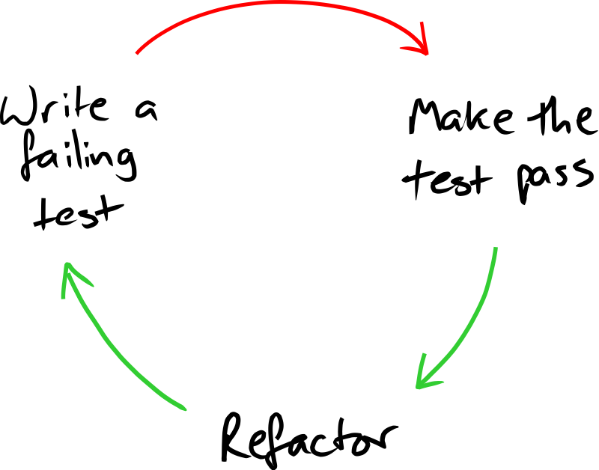

Notes:
Prompt: acknowledge Nat Pryce and GOOS

Slide 4
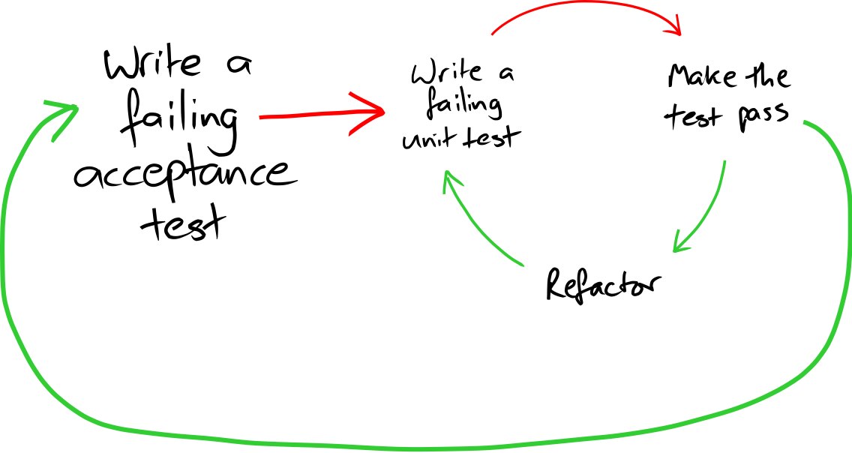

Slide 5

Notes:
Tools.
There are a bunch of tools that can support us in this endeavour

Slide 6
Notes:
Mention:
Gherkin in the same sentence as Cucumber (the former is the natural language parser)
Fit in the same sentence as FitNesse (the former is the predecessor and is in use by no sane person)
For the purpose of this session, we’ll be looking at Concordion.

Slide 7
Notes:
David’s connection to BSkyB, Nat and Steve etc

Slide 9
ACCOUNT
Notes:
What are we doing?
We’re building on the bank account system your TDD’ed in the previous session and we’re going to ask you to implement additional features.
To help get you started, here’s an example

Slide 10
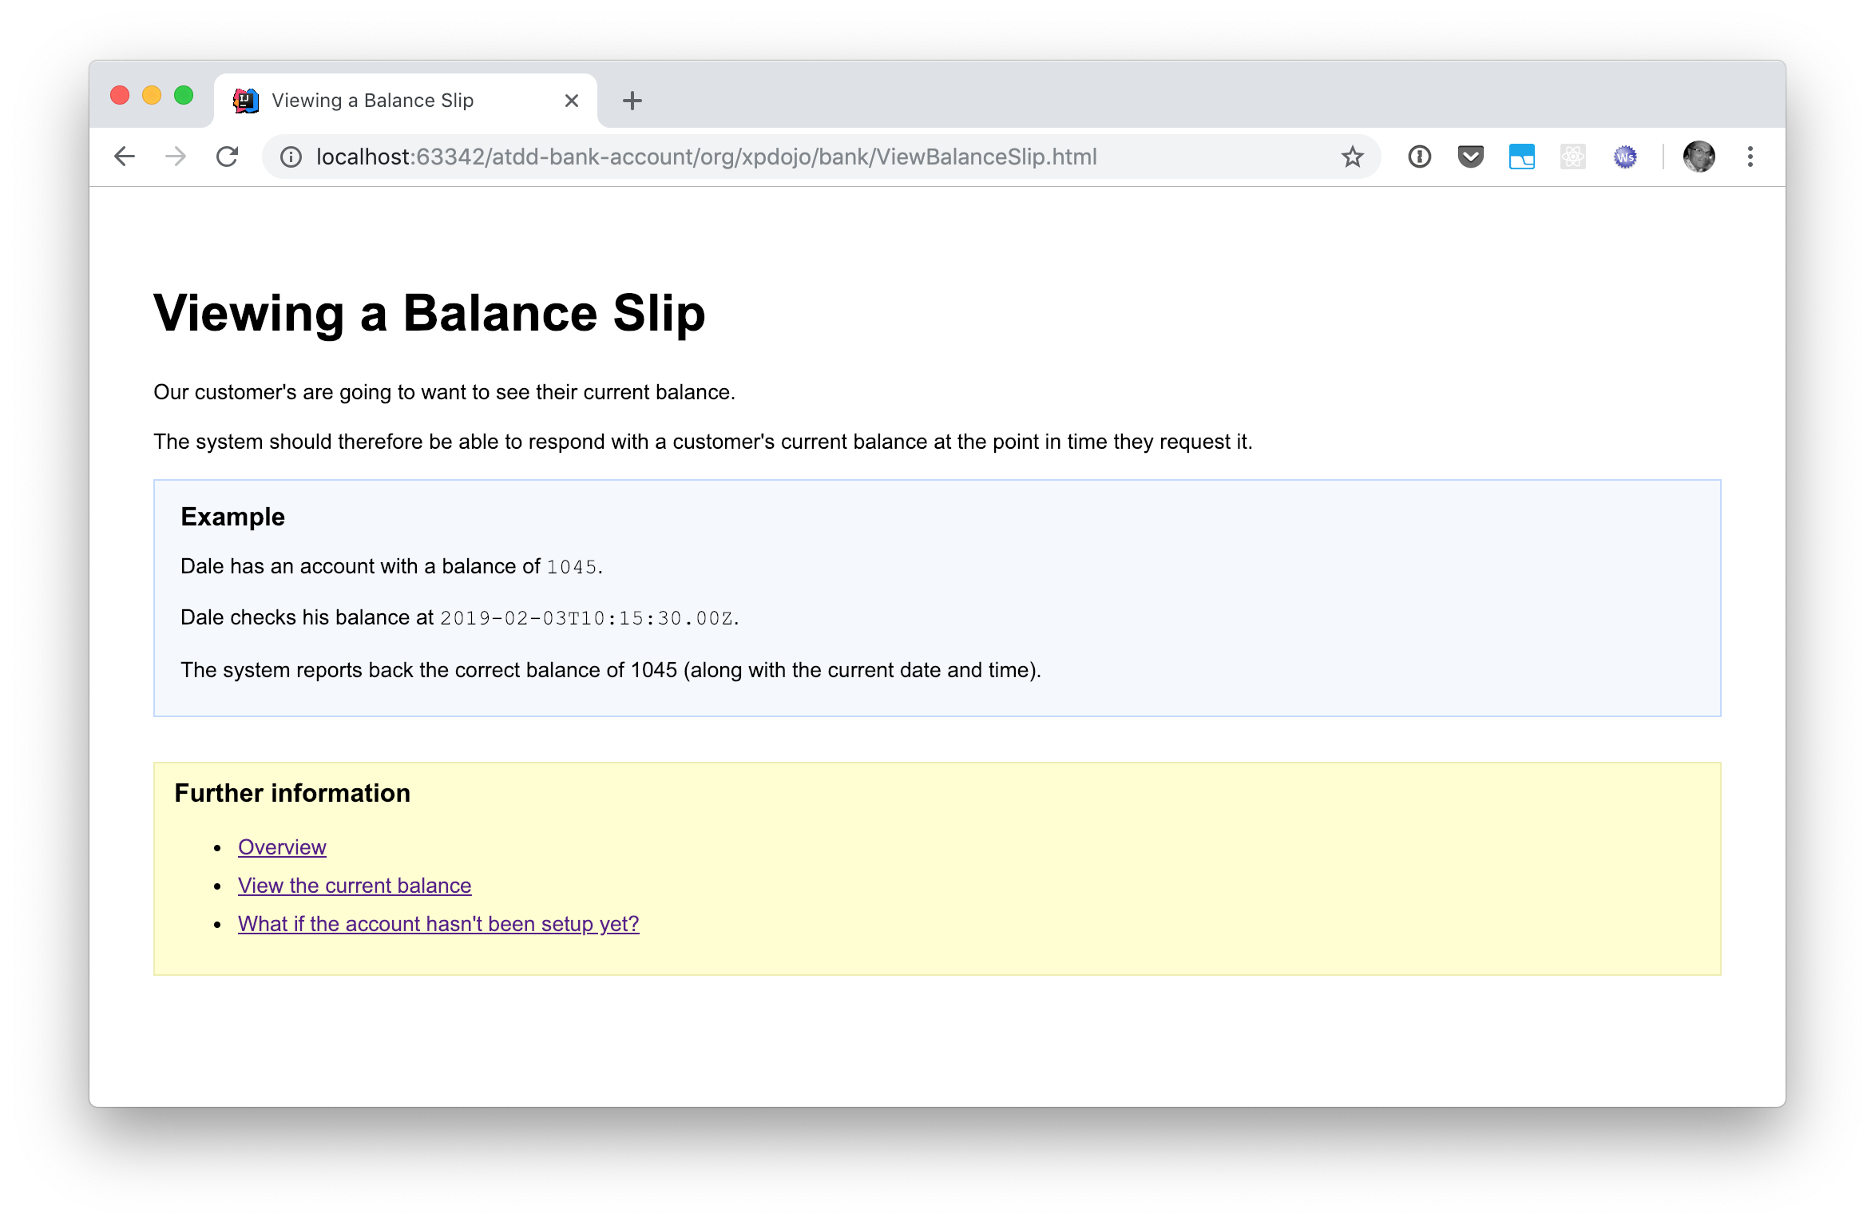
The Specification
Notes:
This is the “specification”

Slide 11
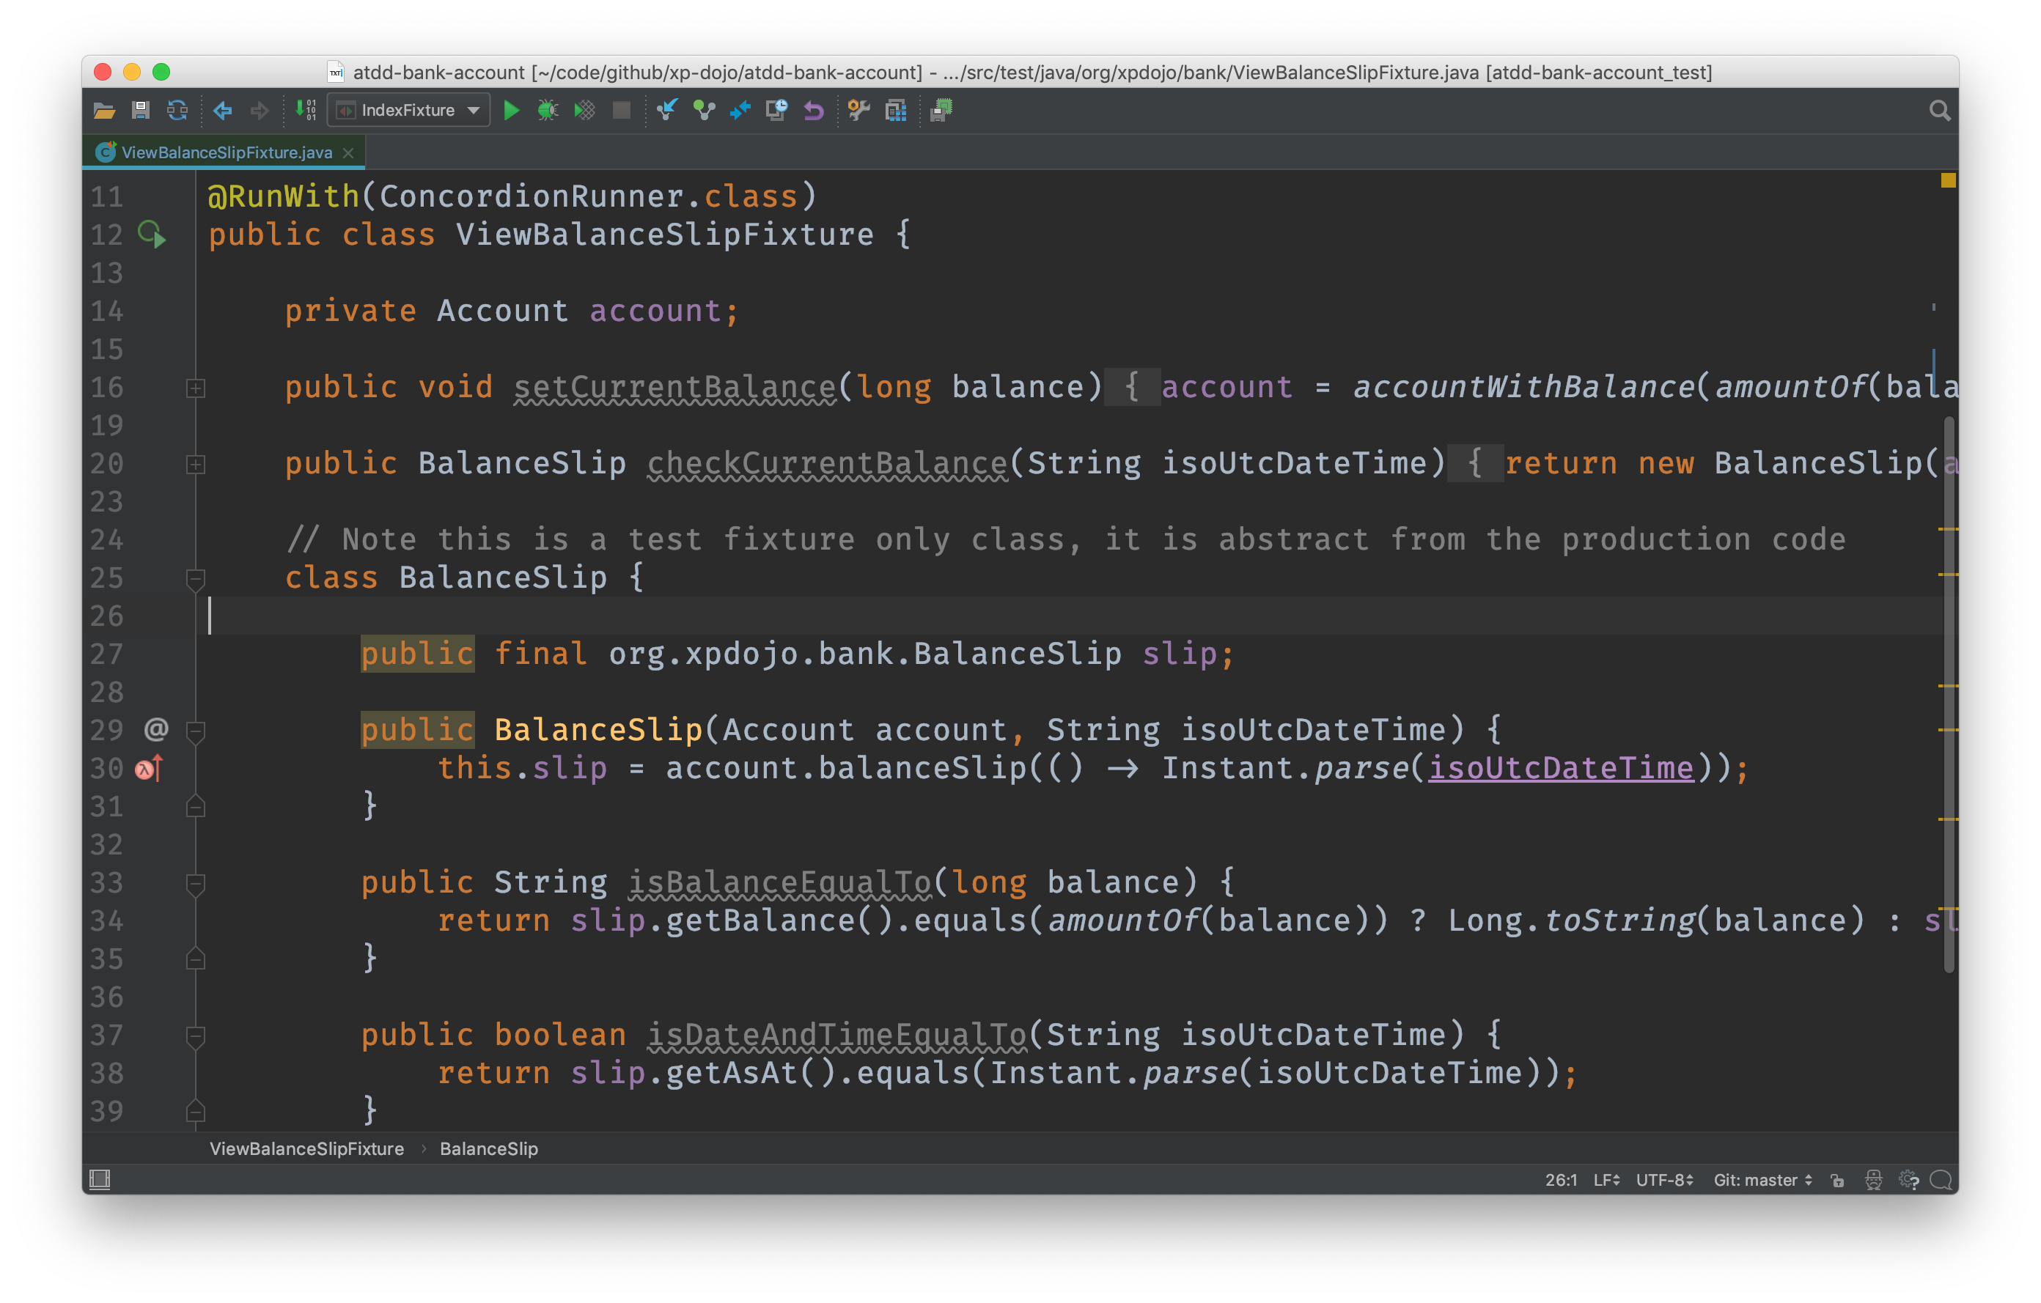
The Fixture
Notes:
This is the “fixture”

Slide 12
The System Under Test
Notes:
This is the “system under test”

Slide 13
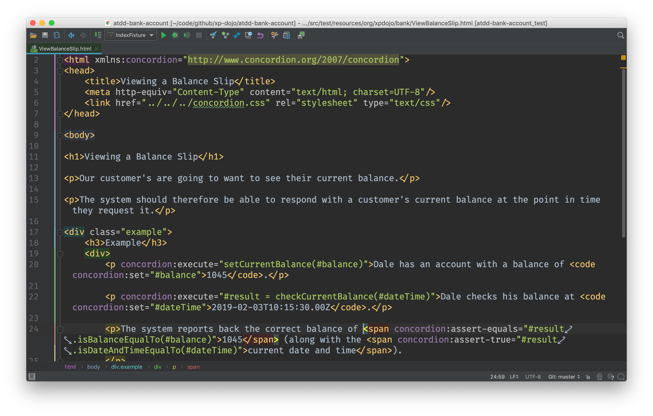
The “Glue”
Notes:
This is how you glue them together (by instrumenting the specification)

Slide 14
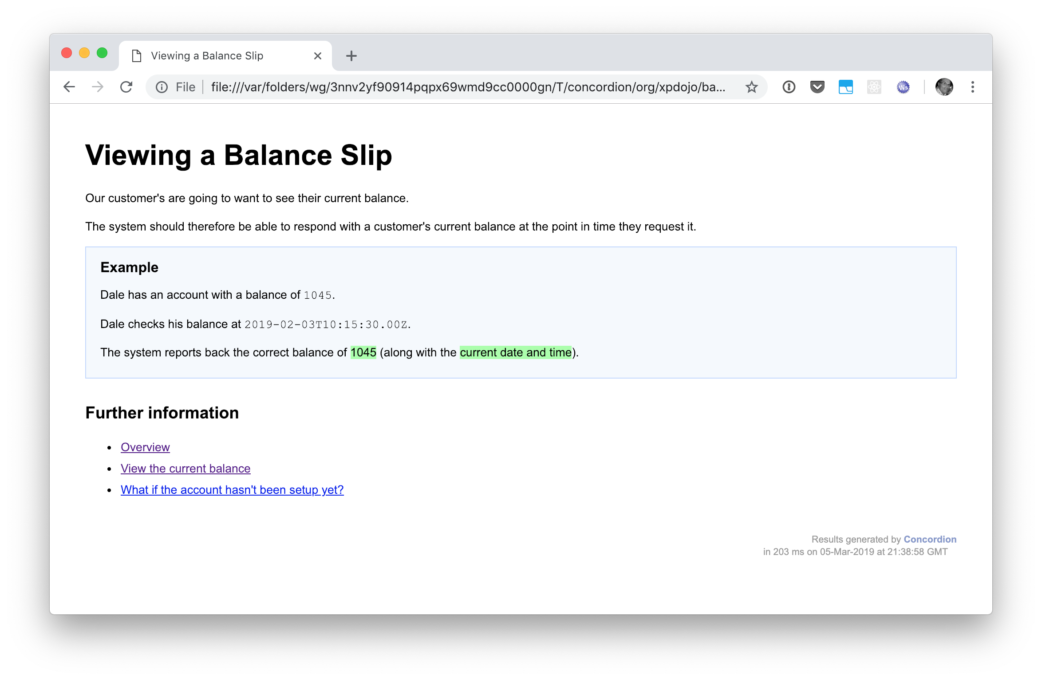
The Result
Notes:
This is the result of running the test

Slide 15
Timings
Introduction 10 mins
Coding 80 mins
Wrap-up 30 mins
120 mins
Notes:
Quick run down on timings
”After the 2 hours … PROFIT!”

Slide 16
$
./lets_code.sh
Notes:
Ok lets get coding
Last minute instructions

